Slide 1

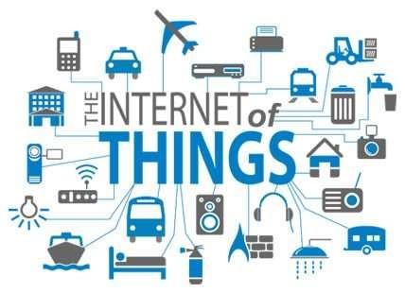
Submitted To:
Mr.Ranjeet Pandey Ms.SeemaYadav
Submitted By: Jaswinder Singh 12EJCCS049
6

Slide 2

Plan of Presentation
What is Internet of Things?
History
How IoT Works?
Few Applications of IoT
Current Status & Future Prospect of IoT
Technological Challenges of IoT
Criticisms & Controversies of IoT
6

Slide 3

What is IoT?
The Internet of Things (IoT) is the network of
"things" embedded with sensors, and network
physical objects or
electronics, software,
connectivity, which enables these objects to collect and exchange data.
6

Slide 4

A “Thing” in the context of the Internet of things (IoT), is an entity or physical object that has a Unique
identifier, an embedded system and the transfer data over a network.
Heart monitoring implants
Biochip transponders on farm animals
Automobiles with built-in sensors
DNA analysis devices & Other Wearbles etc.
ability to
These devices collect useful data with the help of various existing technologies and then autonomously flow the data between other devices.
6

Slide 5
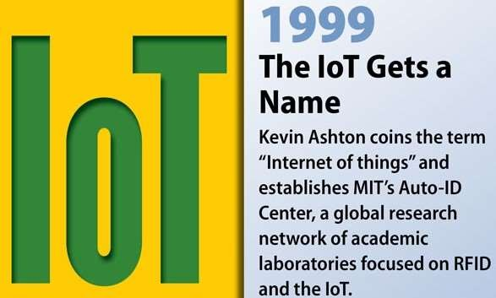
History of IoT
.
6

Slide 6

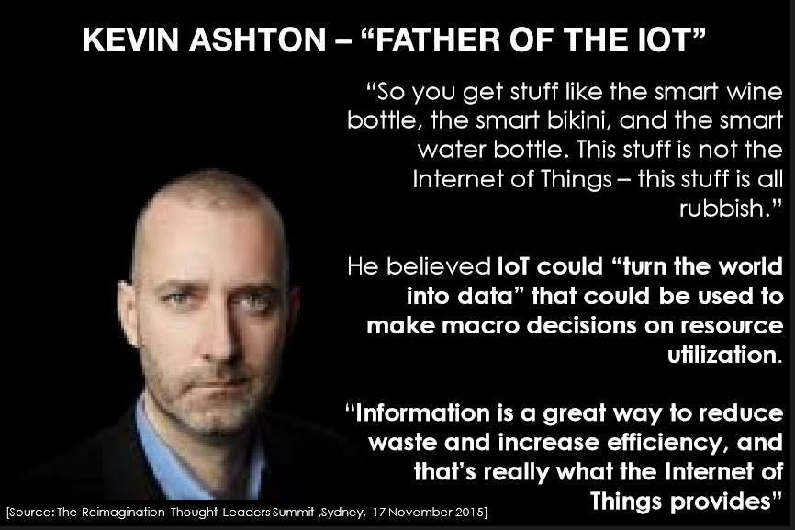
6

Slide 7

How IoT Works?
The Internet of Things (IoT), also sometimes referred to as the Internet of Everything (IoE), consists of all the web-enabled devices that collect, send and act on data they acquire from their surrounding environments using embedded sensors, processors and communication hardware. These devices, often called "connected" or "smart" devices, can sometimes talk to other related devices, a process called machine-to-machine (M2M) communication, and act on the information they get from one another. Humans can interact with the gadgets to set them up, give them instructions or access the data, but the devices do most of the work on their own without human intervention. Their existence has been made possible by all the tiny mobile components that are available these days, as well as the always- online nature of our home and business networks.
6

Slide 8

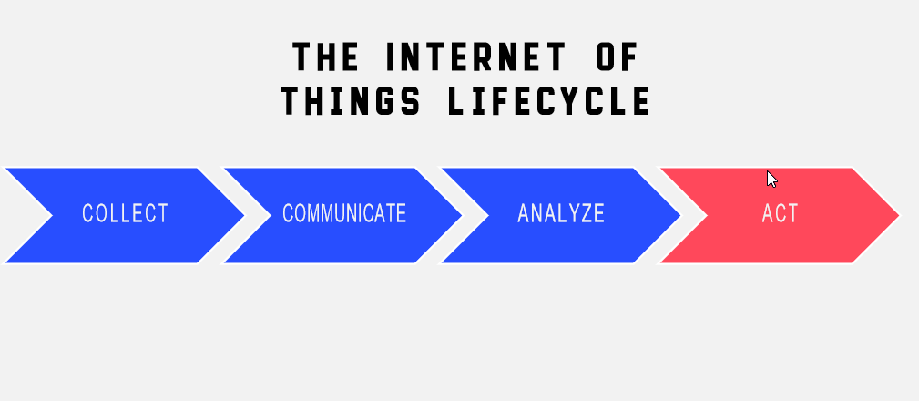
6

Slide 9

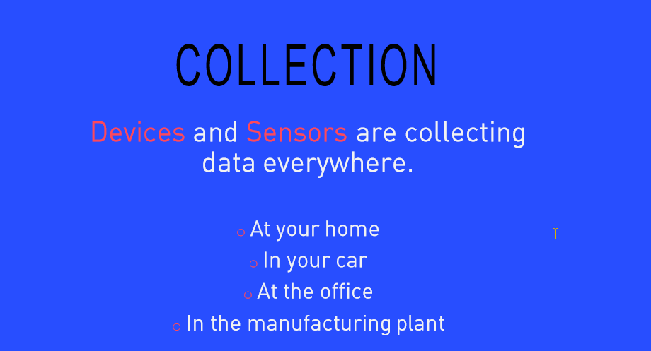
6

Slide 10

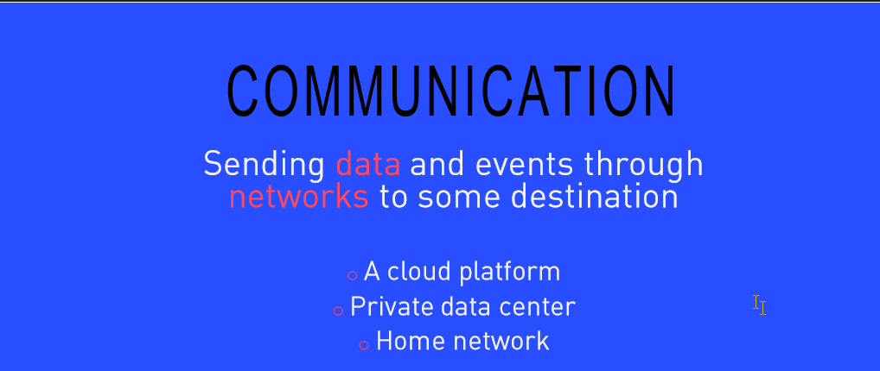
6

Slide 11

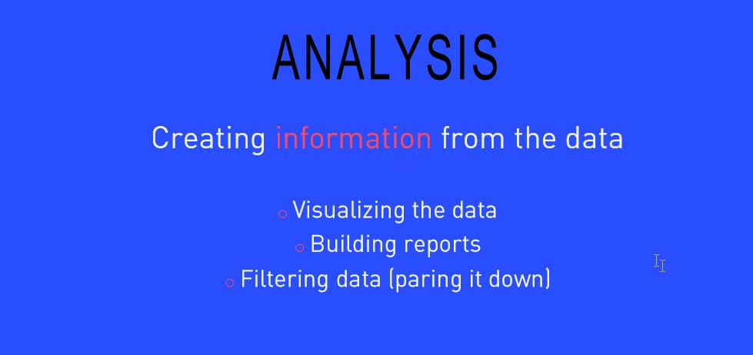
6

Slide 12

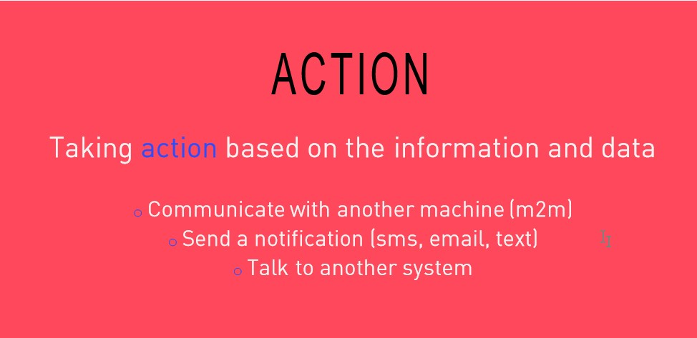
6

Slide 13






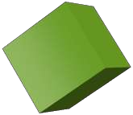
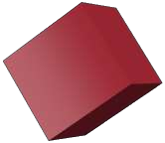

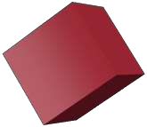
How IoT Works?
RFID
Sensor
Smart Tech
Nano Tech
To identify and track the data of things
To collect and process the data to detect the changes in the physical status of things
To enhance the power of the network by developing processing capabilities to different part of the network.
To make the smaller and smaller things have the ability to connect and interact.
13

Slide 14

The Structure of IoT
The IoT can be viewed as a gigantic
network
consisting of
networks of devices and computers
connected through a series of intermediate technologies where numerous technologies like RFIDs, wireless connections may act as enablers of this connectivity.
Tagging Things : Real-time item traceability and addressability by RFIDs.
Feeling Things : Sensors act as primary devices to collect data from the environment.
Shrinking Things : Miniaturization and Nanotechnology has provoked the ability of smaller things to interact and connect within the “things” or “smart devices.”
Thinking Things : Embedded intelligence in devices through sensors has formed the network connection to the Internet. It can make the “things” realizing the intelligent control.

Slide 15

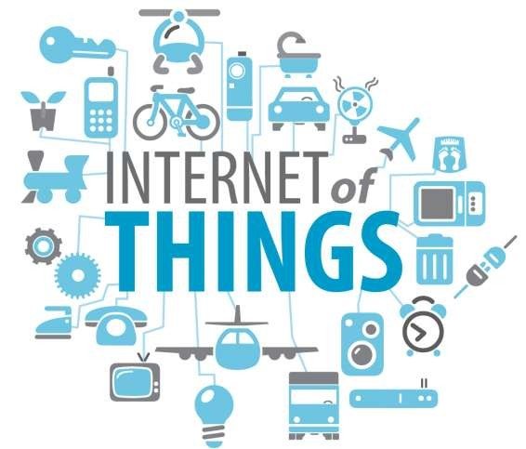
Applications of IoT
"The Ultimate Goal of IOT is to Automate Human Life."

Slide 16

Few Applications of IoT
Building and Home automation
Manufacturing
Medical and Healthcare systems
Media
Environmental monitoring
Infrastructure management
Energy management
Transportation
Better quality of life for elderly
... ... ...
You name it, and you will have it in IoT!

Slide 17
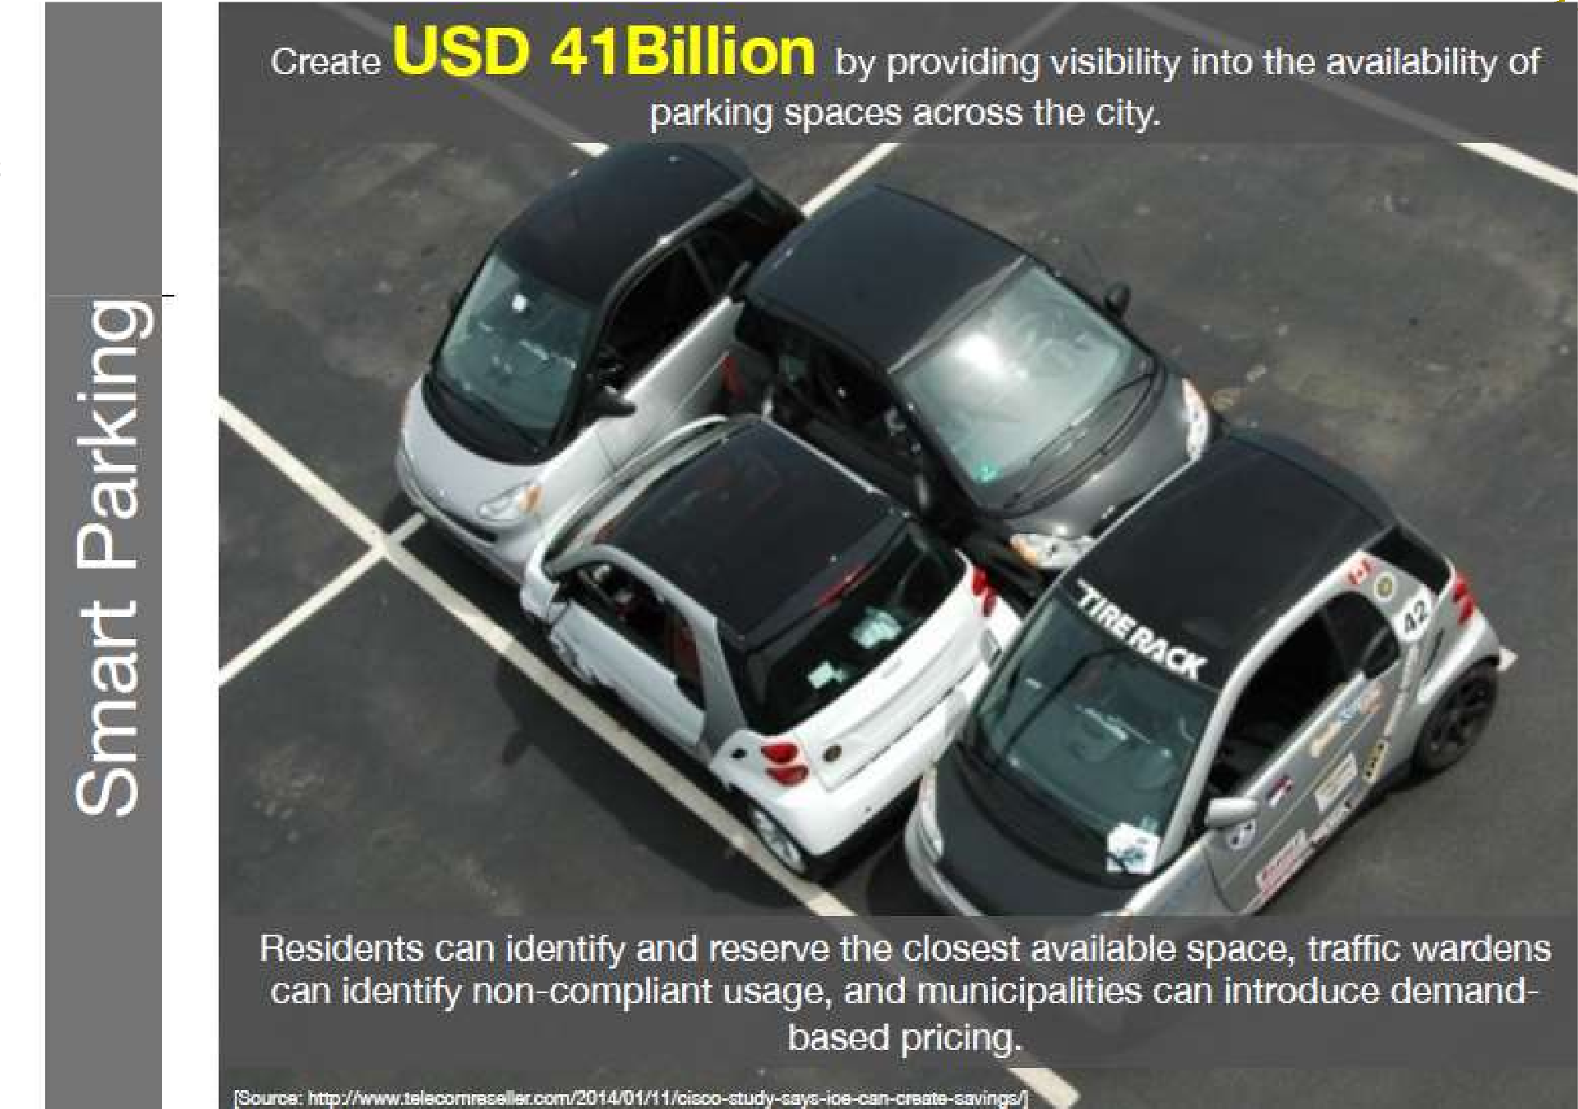


Slide 18
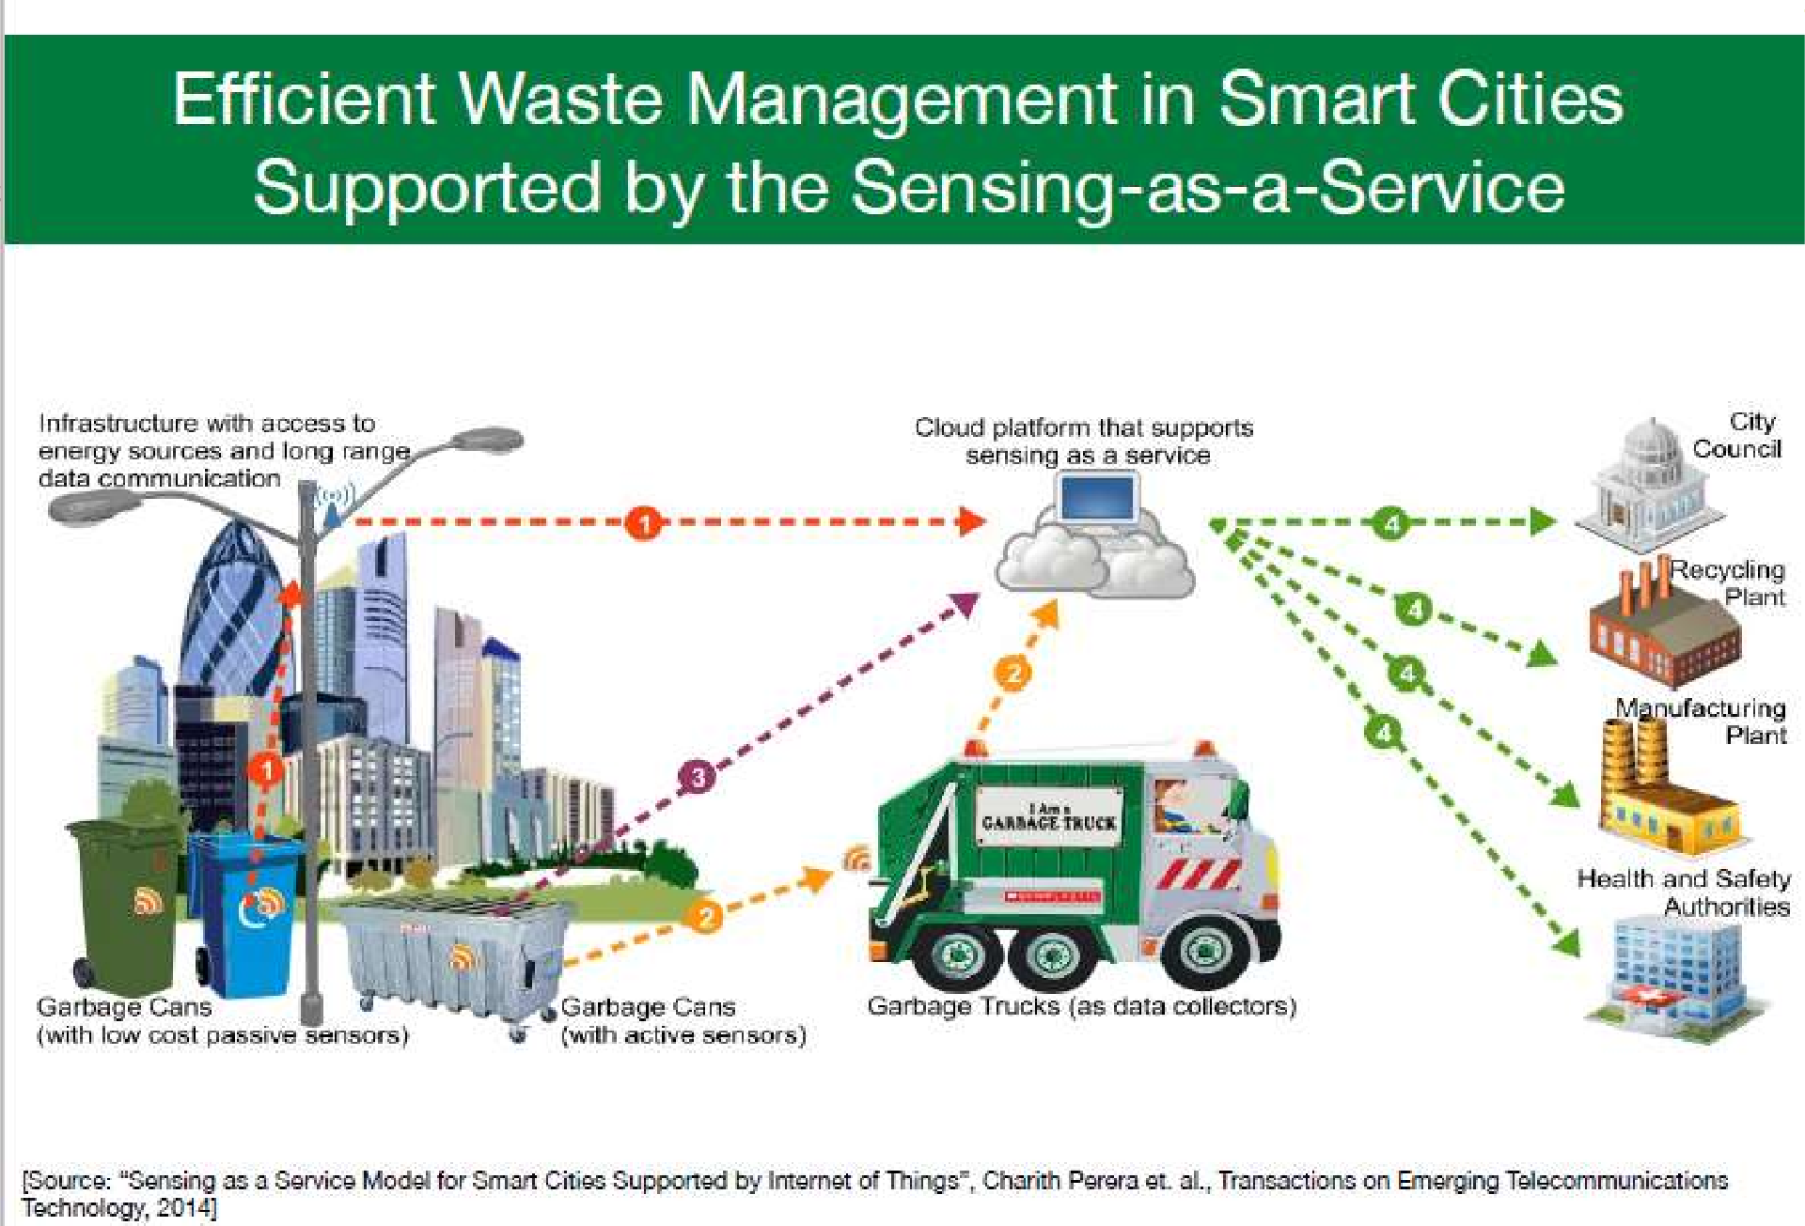


Slide 19

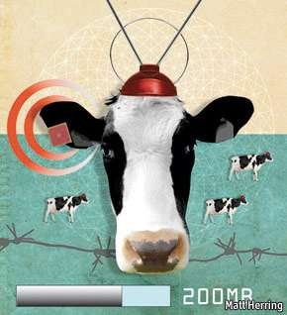
Sensors in even the holy cow!
In the world of IoT, even the cows will be connected and monitored. Sensors are implanted in the ears of cattle. This allows farmers to monitor cows’ health and track their movements, ensuring a healthier, more plentiful supply of milk. On average, each cow generates about 200 MB of
information per year.
19

Slide 20
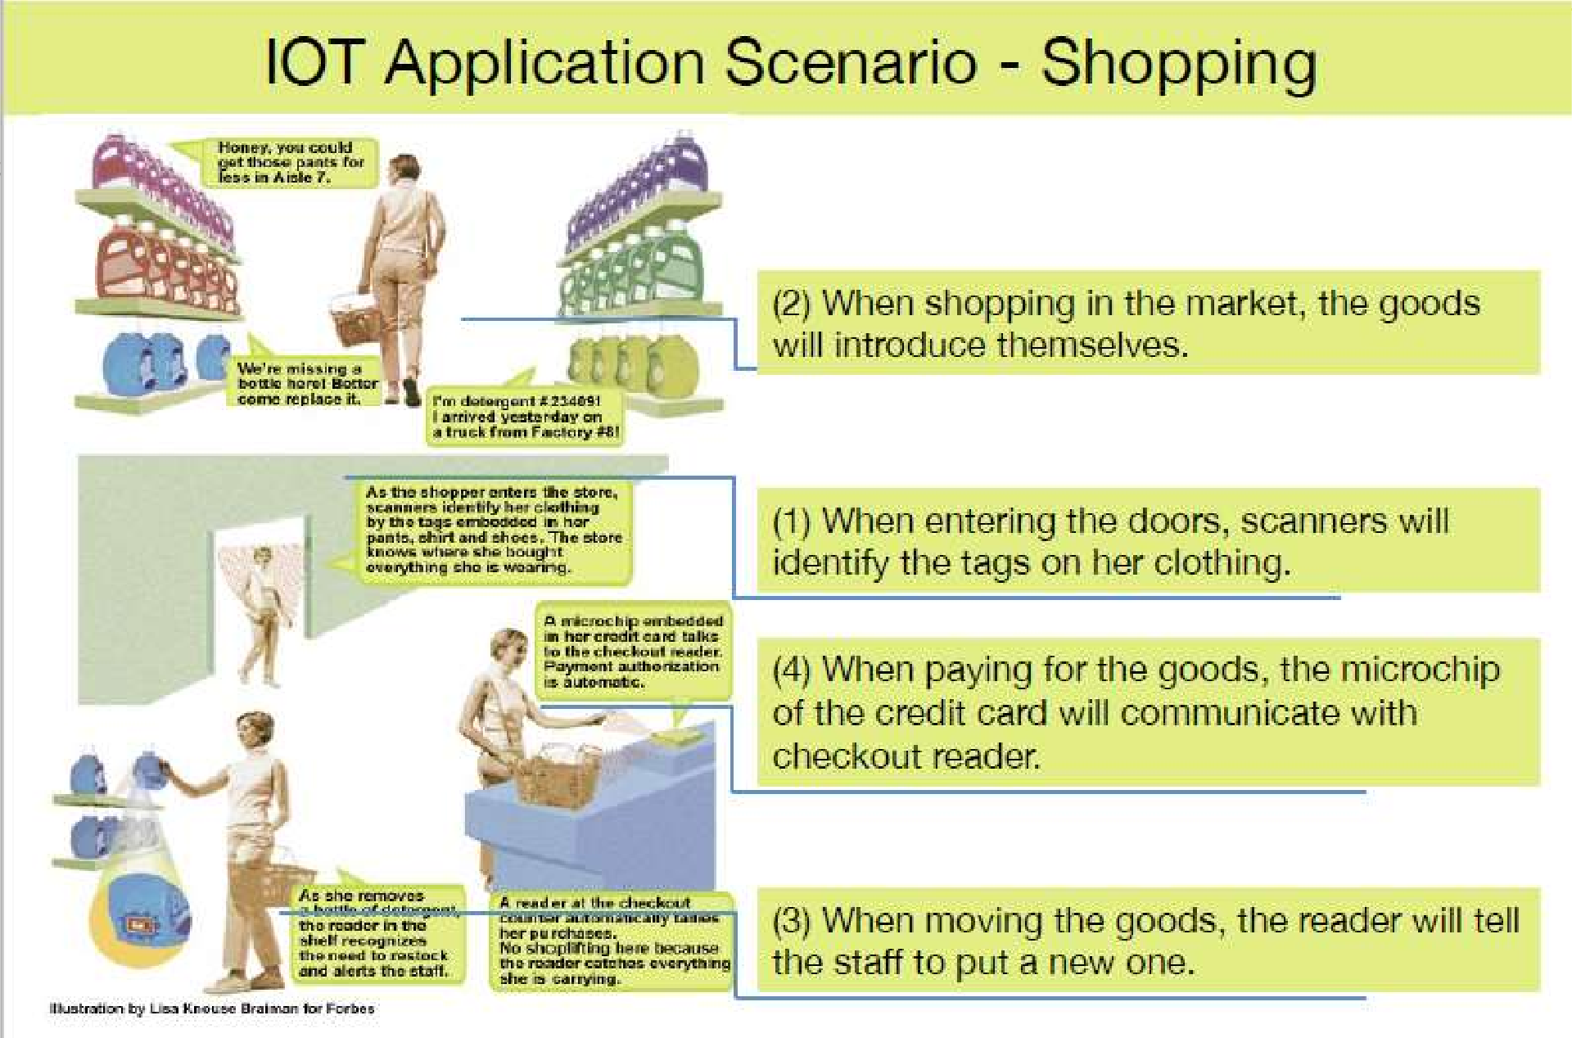


Slide 21



Slide 22
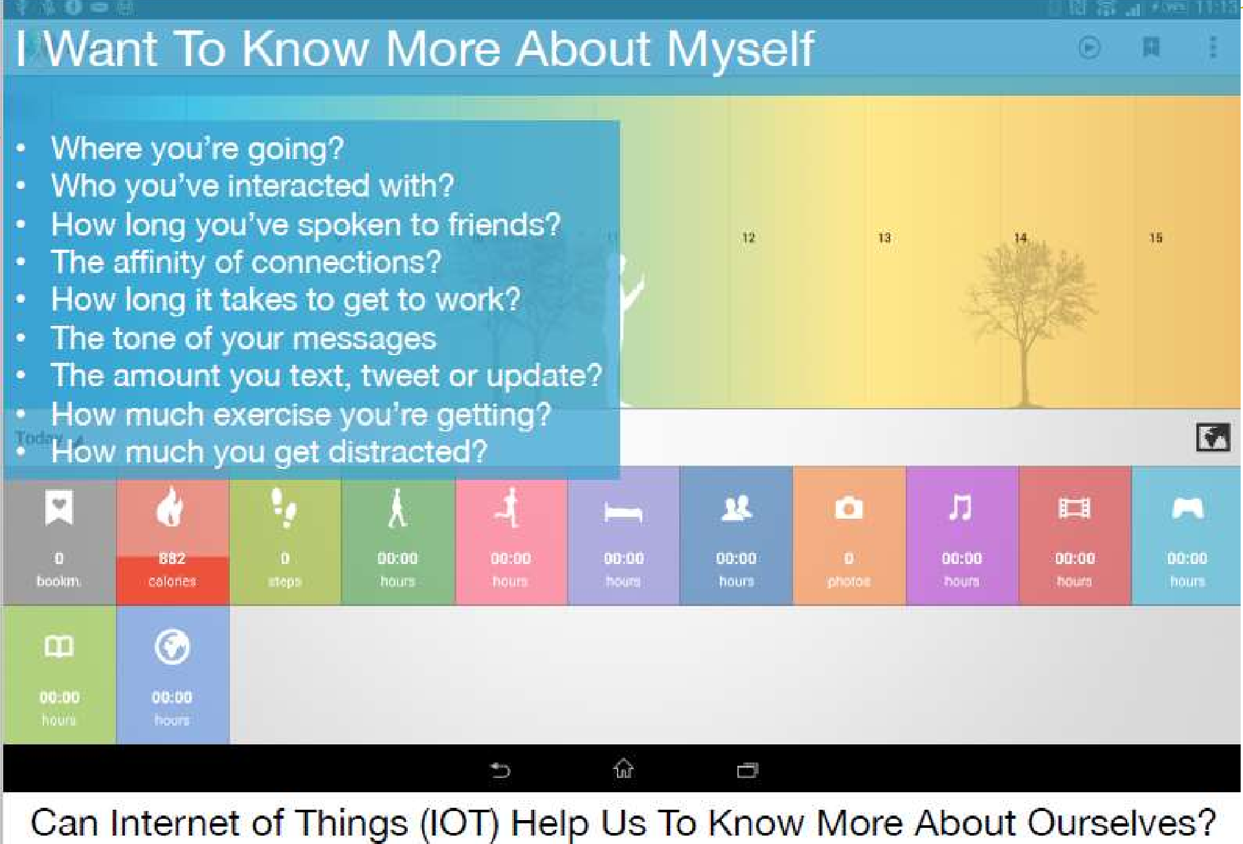

IoT helps you in LIFE LOGGING
22

Slide 23
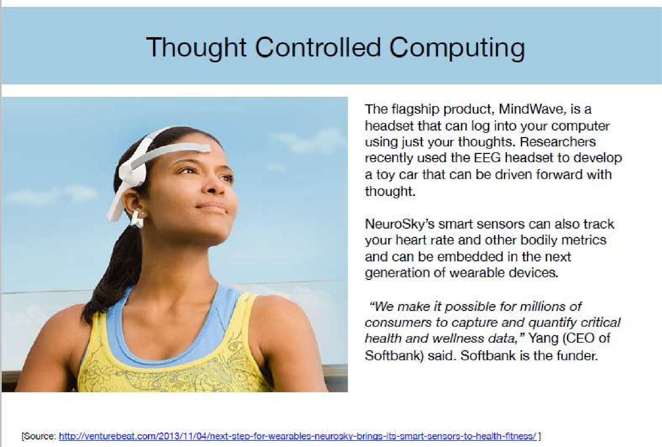


Slide 24

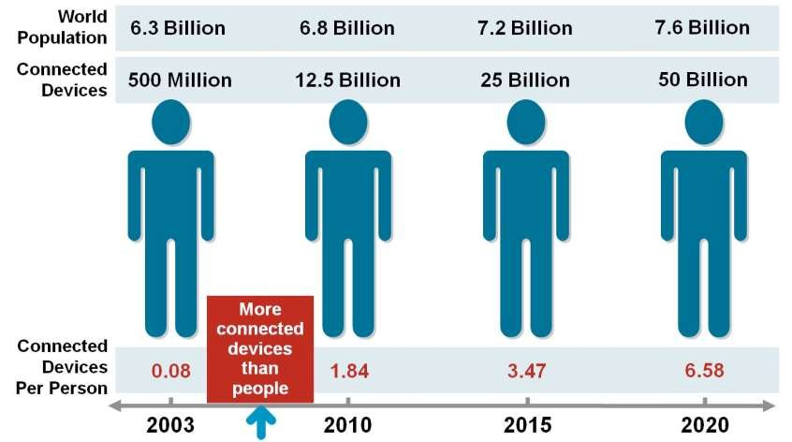
Current Status & Future Prospect of IoT
“Change is the only thing permanent in this world”

Slide 25

TECHNOLOGICAL CHALLENGES OF IoT
At present IoT is faced with many challenges, such as:
Scalability
Technological Standardization
Inter operability
Discovery
Software complexity
Data volumes and interpretation
Power Supply
Interaction and short range communication
Wireless communication
Fault tolerance

Slide 26
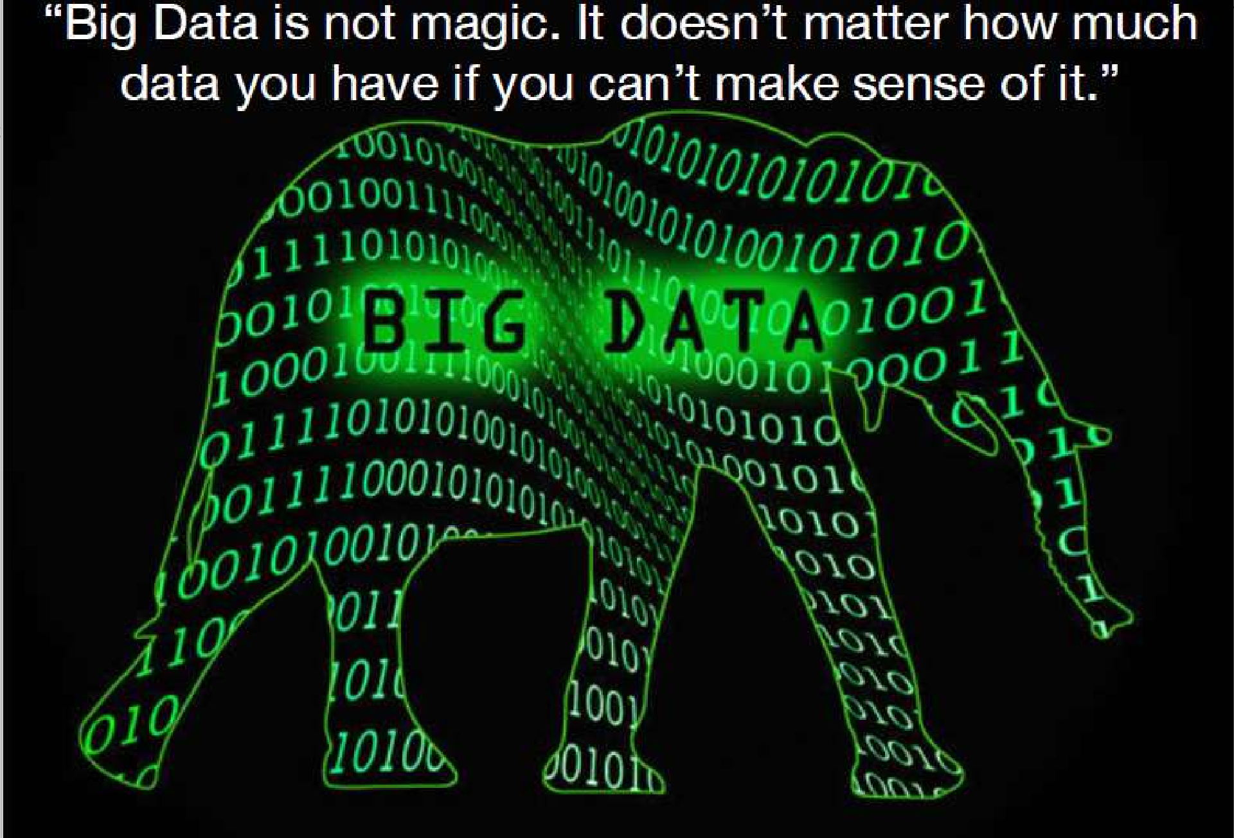


Slide 27

Criticisms and Controversies of IoT
Scholars and social observers and pessimists have doubts about the promises of the ubiquitous computing revolution, in the areas as:
Privacy
Security
Autonomy and Control
Social control
Political manipulation
Design
Environmental impact
Influences human moral decision making

Slide 28
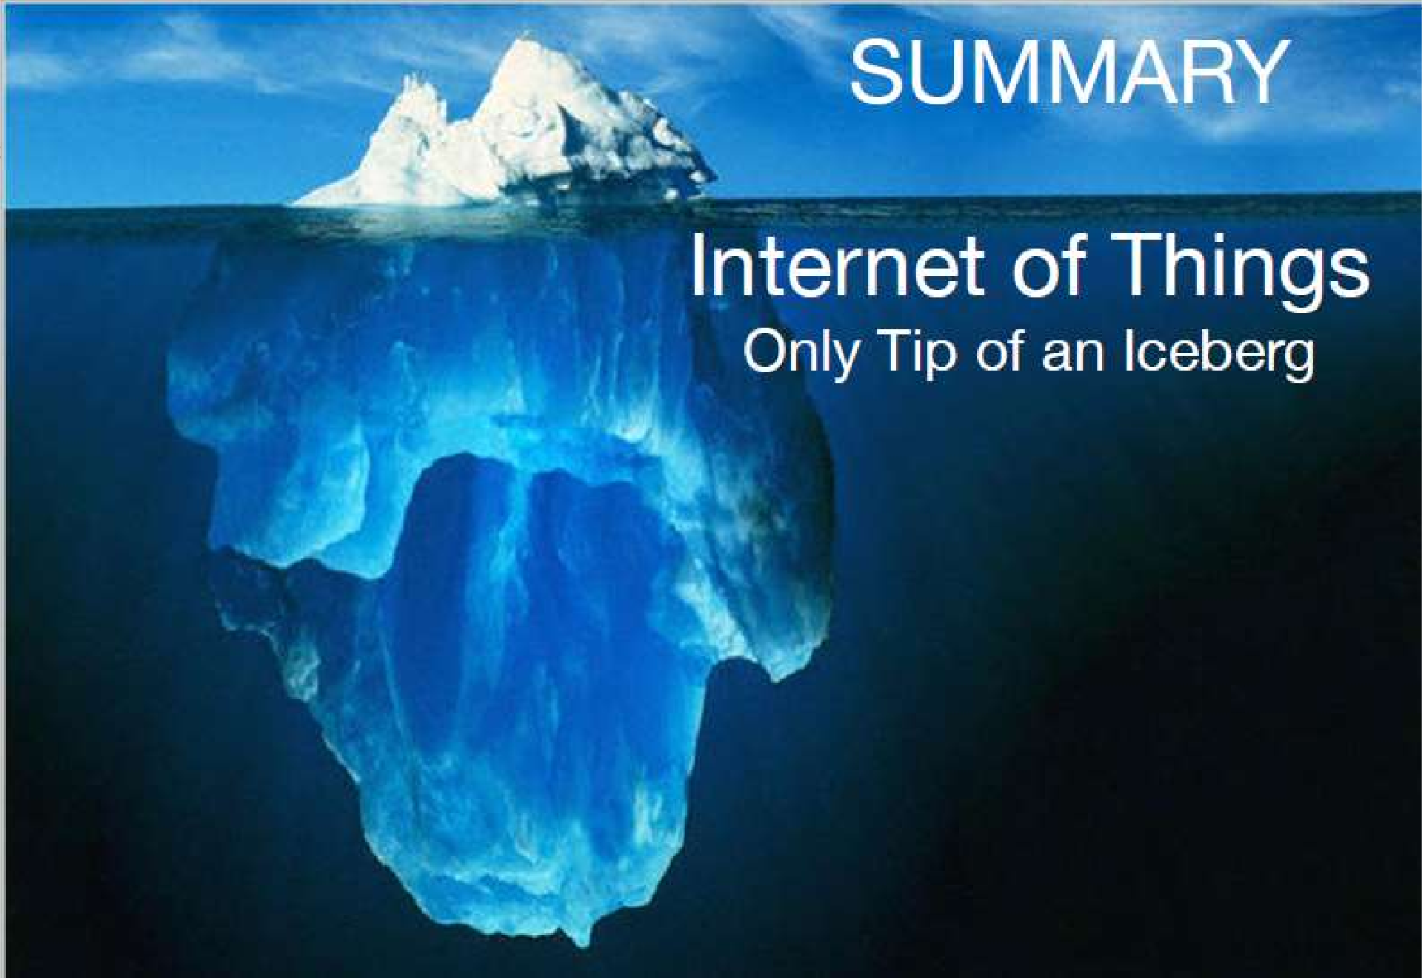


Slide 29
THANK YOU

